Slide 1
Investing in our
Local Health Departments: How Our Funding Decisions Today will Determine California’s Future
June 30, 2020

Slide 2
Public health plays a critical role in nearly every aspect of our lives

Slide 3
Investments in our local health departments will create healthy, vibrant communities for all

Slide 4
What Public Health Does
Public health touches every aspect of our day, from the water we drink to the air we breathe
When all is well, public health professionals are largely invisible
Amid COVID-19, many are learning what public health means for the first time & why having a well-resourced public health system is critical to keeping communities across California safe and healthy

Slide 5
Essential Services
Local health departments provide essential services in the communities we serve, such as:
Organizing testing and follow-up
Collecting data on health outcomes
Creating nutrition and active living programs

Slide 6
From Clinics to Community
Local health departments work year-round to address the social factors that touch our lives:
Access to safe and stable housing
Increase food security
Expand employment opportunities

Slide 7
Local health departments build authentic relationships with community members and community-based organizations, making them key partners during a public health emergency like COVID-19, and long-term as we work toward a just recovery.

Slide 8
Addressing Health Equity
Local health departments play a unique role educating non-health sectors & policymakers on structural factors & community conditions that perpetuate racial and health inequities
They connect health data with these inequities and tie it to policy & system change
They are well positioned to work with residents of communities that face multiple, intersecting inequities & challenges to health & safety

Slide 9
Data & Health Equity
Well-resourced public health departments can…
Hire dedicated health equity staff to advance equity & are best positioned to prevent disproportionate impacts of health, economic and other emergencies in the future
Use data & GIS systems & skilled staff to collect, analyze, & disseminate useful equity-related data to influence policy

Slide 10
Addressing Climate Change
The health and economic impacts of climate emergencies are far reaching
Extreme heat, floods, wildfires, and droughts have already caused thousands of deaths and displaced tens of thousands of people
Most LHDs do not have dedicated climate change staff
As climate change exacerbates the potency of extreme weather events, we must invest in California communities and public health systems to increase resilience to climate impacts.
“Climate change is the biggest global health threat of the 21st century”
– The Lancet, 2009

Slide 11
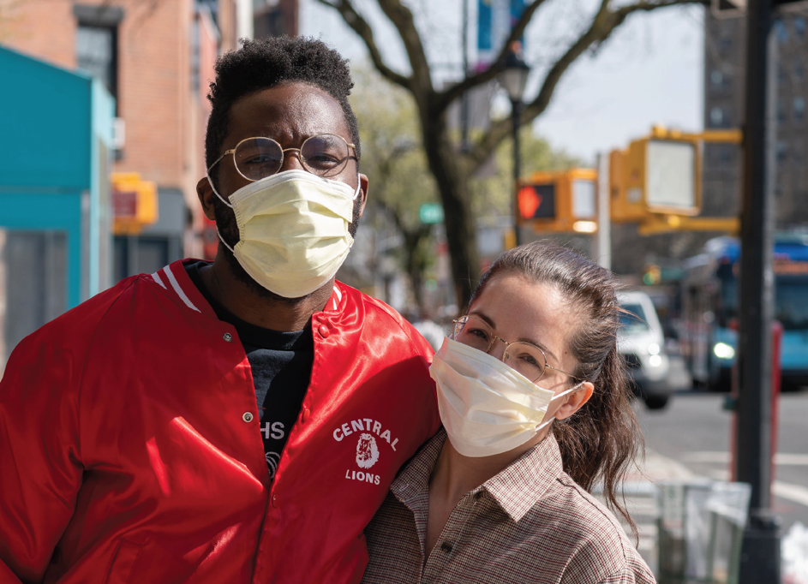
Addressing Health Equity
Well-resourced public health departments that possess data and GIS systems and skilled staff are able to collect, analyze, interpret, and disseminate useful equity related data to influence and create policy and systems change
Departments with dedicated staff to advance equity are best positioned to prevent disproportionate impacts of health, economic and other emergencies in the future

Slide 12
Investing in Public Health Saves Lives and Money
For every one dollar we invest in prevention-focused initiatives,
our health care system yields an average $5.60 in savings

Slide 13
Investing in Public Health Saves Lives and Money
Example: In Los Angeles County, every $10 per capita spent on public health would result in:
2,222 more people in very good or excellent health
7,271 years of life gained
among county residents
10
Decrease of 403 cases of salmonella per year
204 fewer new cases of HIV, hepatitis A and B, and tuberculosis
822 fewer gonorrhea cases per year and 343 early stage syphilis cases per year

Slide 14
Investing in Public Health Saves Lives and Money
[Insert Local Example here]
Increase 2
Increase 1
$X
Decrease 1
Decrease 2

Slide 15
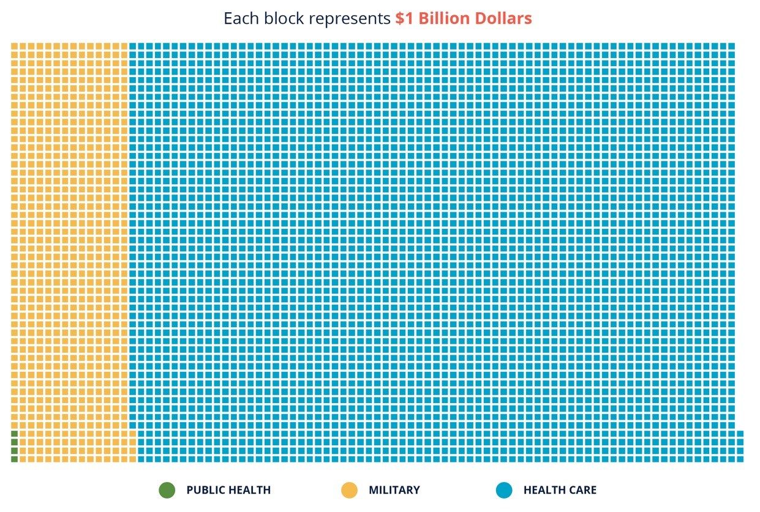
We Aren’t Investing Enough in Public Health
We spend an estimated $3.6 trillion annually on health care, but less than 3% of that is spent on public health and prevention infrastructure

Slide 16
Public Health Funding Is Declining
Over the past decade alone, local and state health departments lost 20% of their workforce, and LHD budgets shrank by as much as 24%
Nearly all funding sources are declining while public health threats and climate disasters are growing
Under-resourced staff are working long hours for the COVID-19 response, while departments are understaffed, leaving them unprepared to respond to this or the next emergency
$
Restrictive categorical funding structure – less than 5% of funding is flexible

Slide 17
Federal Funding Cuts
Funding for Public Health Emergency Preparedness decreased from $940 million in 2002 to $675 million in 2020.
The CDC and HHS decreased allocations to California LHDs from $81 million in 2010 to $65 million in 2019, a 25% decrease.
Cuts to Prevention Fund Since Creation FY 2010-2028 (IN MILLIONS)

Slide 18
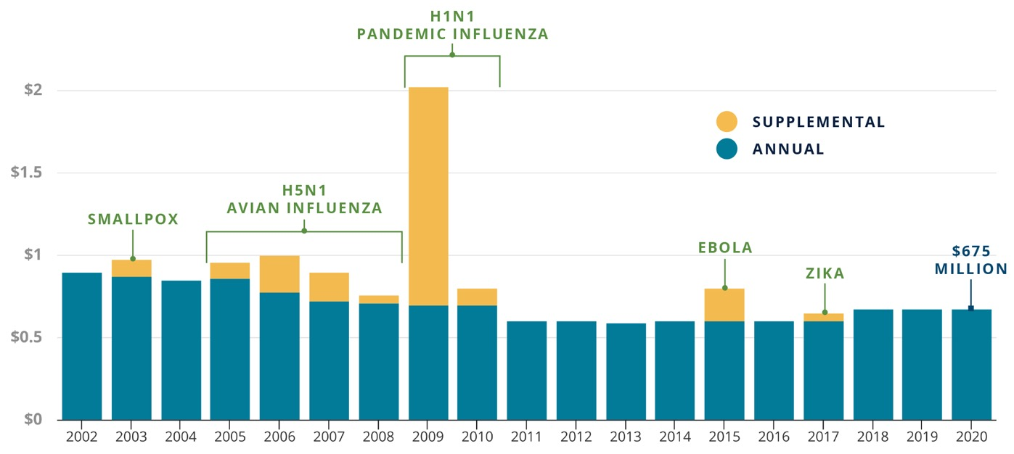
Federal Funding Cuts
Additional health funding surges in times of disease, outbreaks, pandemics but decreases once threats have subsided
PUBLIC HEALTH EMERGENCY PREPARATION AWARDS (IN BILLIONS)

Slide 19
California Funding Cuts
This year, the State budget cut public health funding from $3.4B to $3.2, a 6.3% decrease despite the ongoing pandemic
LHDs receiving $177 million less in total funding in 2018-2019 vs. 2007-2008, while general funds to LHDs decreased by $90M, including for infectious disease control, chronic disease and emergency preparedness
11 local public health labs closed over the past 15 yrs, limiting the COVID-19 testing capacity and staffing needed to adequately meet reopening goals
$

Slide 20
Local Funding Cuts
County general funding remains flat and local health departments have to compete with other agencies for funding
[INSERT LOCAL EXAMPLES HERE] or use example below:
In Riverside County the health department has ~ $100M budget/yr, & the Board of Supervisors allocates $12 million from the County General Fund. This amount has been flat for years amid competing priorities while public health threats are growing. As a result, Riverside cut its LHD staff by about 60% over the past decade.
Due to COVID-19, sales tax and vehicle license fee revenues have declined, leading to a $1.7 billion loss in county revenue that will impact LHD budgets
$

Slide 21
Existing Funding Constraints
1
Most of our funding is categorical – less than 5% is flexible
The categorical nature of public health funding makes it difficult to shift funding to address other priorities or emergencies: we are not able to be as nimble in emergency situations when they need to respond quickly
2
2
Flexible funding sources, such as Realignment, are in decline, dependent on fluctuating revenue sources, and often diverted for other county priorities
3
3

Slide 22
Existing Funding Constraints
Emergency infusions are temporary, leaving local health departments without the staffing and resources to prepare for the next emergency
4
Most LHDs do not have dedicated staff for health equity or climate change, despite the grave threats that systemic racism, historic inequities and climate change pose to our future.
2
5
Disinvesting in local health departments and limiting their ability to address health equity means disinvesting in the communities that experience the worst health inequities and are the most vulnerable to public health emergencies, such as COVID-19 and climate change
3
6

Slide 23
Solution: Invest in Public Health
We need to fund robust and resilient local health departments that can support all residents in times of crisis
and advance a vision of health for all.

Slide 24
Solution: Invest in Public Health
We need more funding from local, regional, state & federal sources, especially flexible and sustained funding, to allow us to:
Hire critical staff, including technical positions (epidemiologists, public health nurses), dedicated staff to focus on health equity and climate change, and develop a cross-cutting workforce
1
2
Purchase new and modernizing existing equipment and facilities
2
3
Enhance data platforms to provide real-time disease surveillance and facilitate data sharing
3

Slide 25
Solution: Invest in Public Health
4
Acquire critical supplies
2
Develop plans and strategies for addressing important public health challenges and emergencies
5
3
Partner with community-based organizations to advance health equity
6

Slide 26
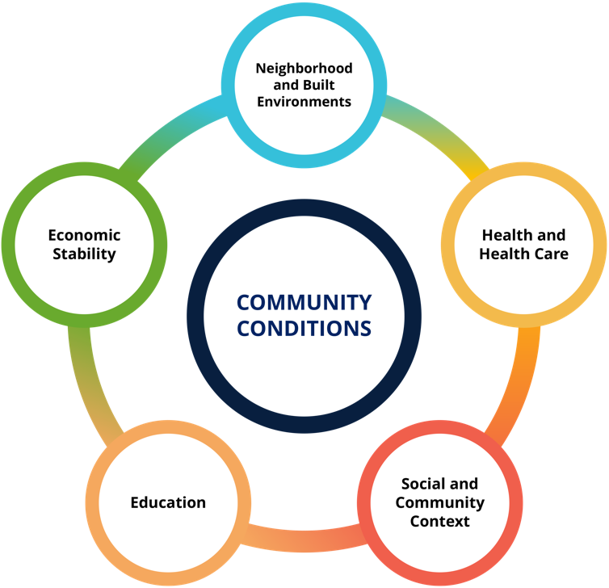
Solution: Invest in Public Health
We need to invest directly in communities most impacted by health inequities
Funding for prevention of chronic disease & improving community conditions
Direct investments to communities to address longstanding health inequities, neighborhood conditions and structural racism
Investing in our communities goes hand in hand with investing in our local health departments

Slide 27
Funding from other sectors to support public health
Traditional funding sources are not enough
Existing health care funding streams should include investments in prevention & local health departments
Grant programs in non-health sectors should expand eligibility
Encourage health care, community development and other sectors to partner with local health departments to align funding (e.g. blending and braiding funding)

Slide 28
Conclusion
Local health departments are at a critical juncture
We must support a comprehensive public health system to protect our society from COVID-19, & prevent the disproportionate impacts of the next public health threat
Investing in funding robust and resilient local health departments will protect our residents most impacted by health inequities and keep everyone safe and healthy

Slide 29
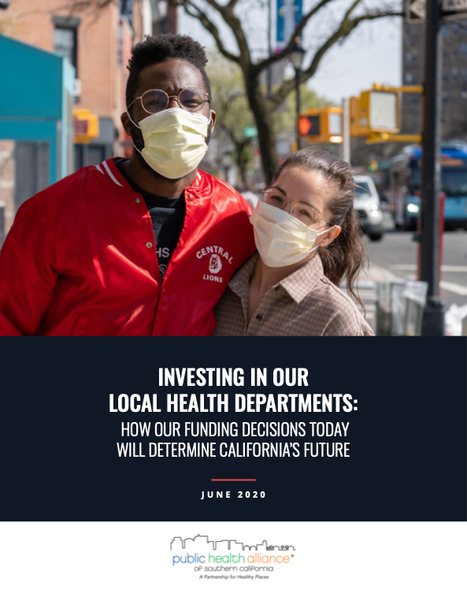
For more information, please check our Public Health Infrastructure resources webpage & report

